Slide 1
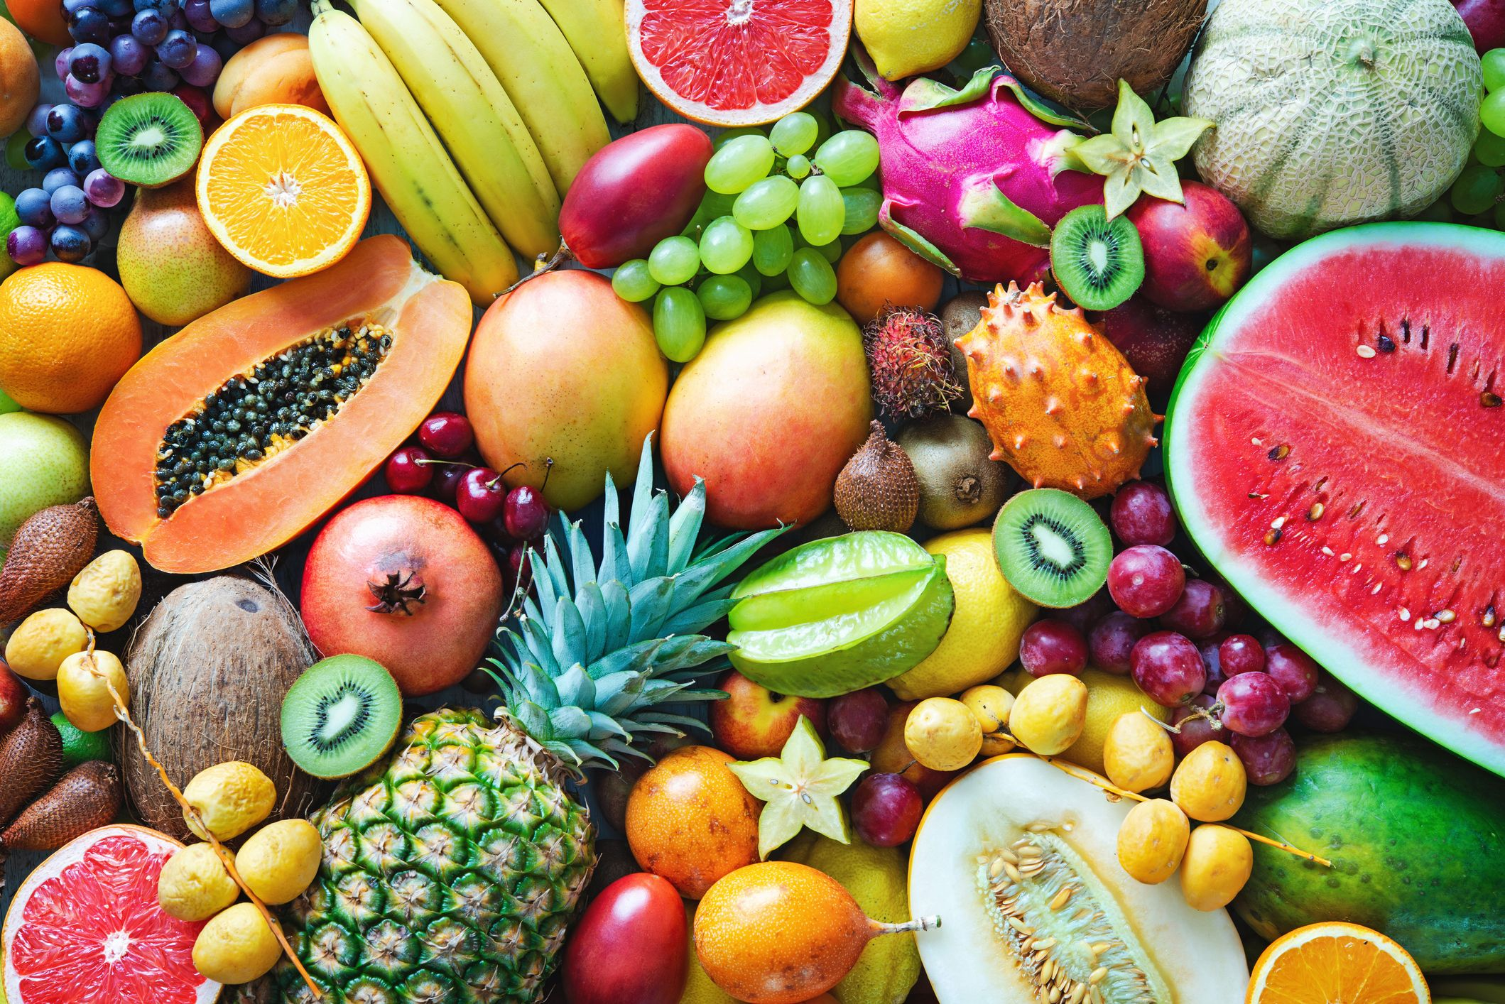
Design And Analysis of Algorithms Isomorphism in biological networks
N.SOWGNA -2010030344
TAHSEEN BEGUM – 2010030168
E.Pravallika – 2010030046
Keerthana Pulugam - 2010030445
Guide: P. Sree Lakshmi

Slide 2
Abstract
Number of real world problems is represented by graph.
Graph isomorphism is the area of pattern matching and widely used in various applications such as image processing, protein structure, computer and information system, chemical bond structure, Social Networks.
This project surveys both various applications of graph isomorphism and their importance in the society.

Slide 3
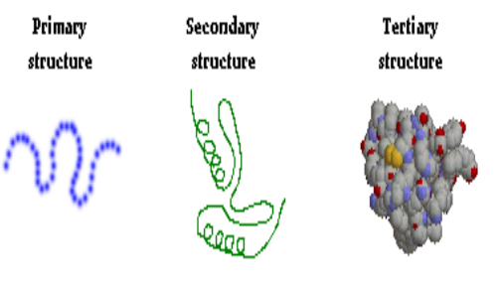
Problem Statement
We Use Protein Structure ,Nodes Represents Protein And Edges Represents Their Interactions Between Nodes.
We Have Three Levels Of Protein Structure I.E. , Primary Structure ,Secondary Structure , Tertiary Structure.
For Example Collection Of Food Is Available And Every Food Is Having Their Own Structure That Is Graph Structure. For Providing The Food And That Food Contains Some Proteins, Then Find Protein Graph Structure First And Check Where It Is Available In The Food Structure Or Not.

Slide 4
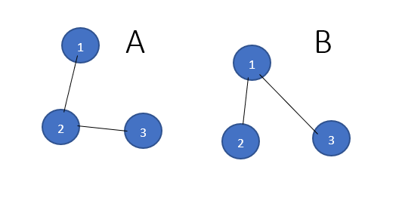
Solution strategy- Algorithm used
We have Graph A and B , now we have to check the two graph are isomorphic are not using VF2 Algorithm
Our vertex are 1,2,3 in graph A and B

Slide 5

Step 1 :
I match empty A with empty B it always works.
We can match 1A with 1B,2B,3B
Now we take 1A with 1B it always works
Step 2 :
I can match 2A with 2B or 3B
I match 2A with 2B always works because 1A,2A and 1B,2B are connected.
Step 3 :
I can match 3A with any node in Graph B we cannot connect because there is no edge between 2B and 3B in graph B , so we will go back to again step2.
Step 4:
I can match with 2A with 3B we cannot connect because there is no edge between 2B and 3B in graph B , so we will go back to again step2,But in step2 we didn’t have solution , so we will go to step1.
Step 5:
I match 1A with 2B and 2A with 1B and 3A with 3B
The graphs are isomorphic

Slide 6
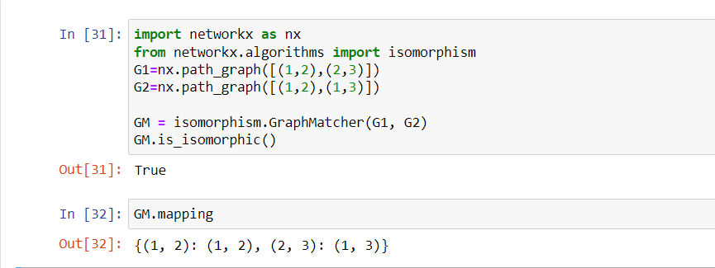
Numeric example of the algorithm (Sample input - expected output)
An implementation of VF2 algorithm for graph isomorphism testing.The simplest interface to is to call networkx.is_isomorphic().

Slide 7
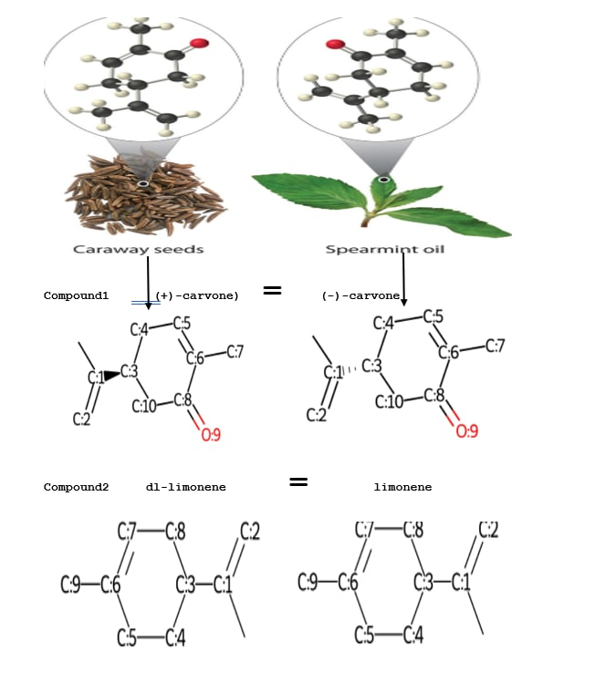
Flow chart of the proposed solution

Slide 8


Hardware and Software used
1)Windows 11 for x64-based system
2) brackets
3) jupyter notebook

Slide 9
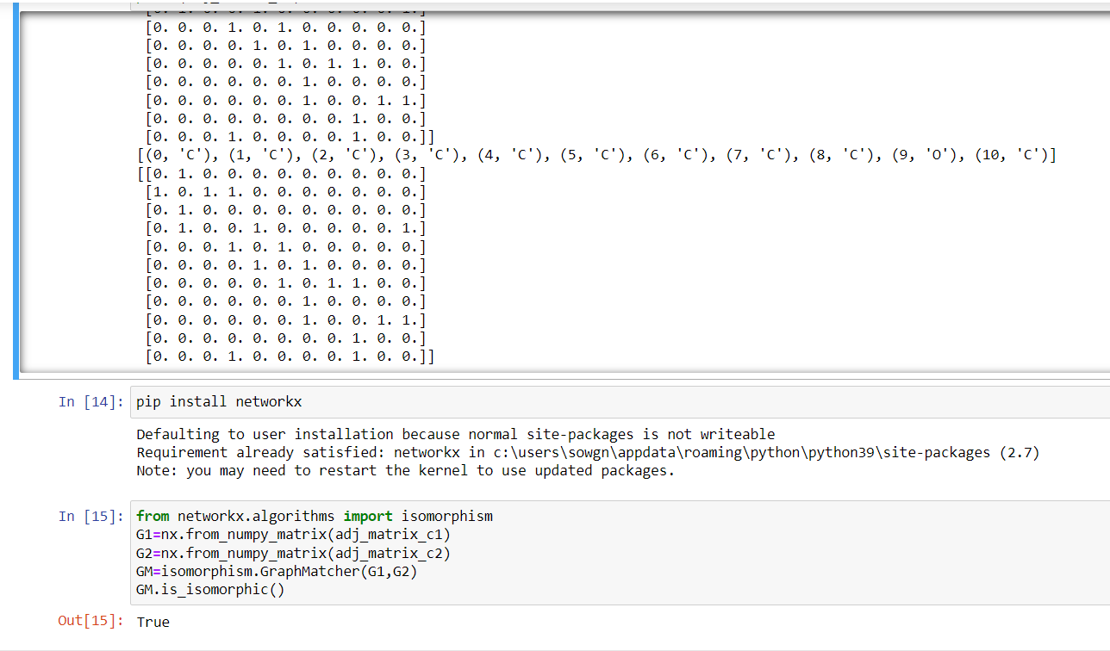
Implementation
We are done with our code.
Done with frontend.

Slide 10
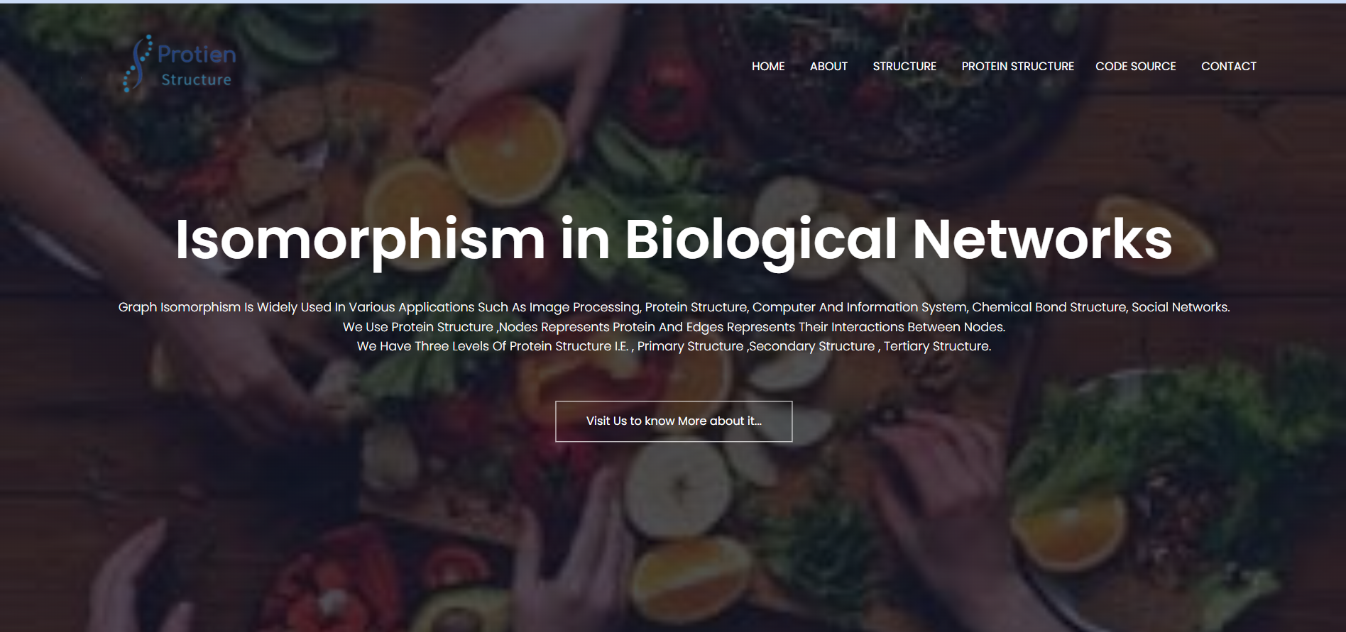
Results

Slide 11
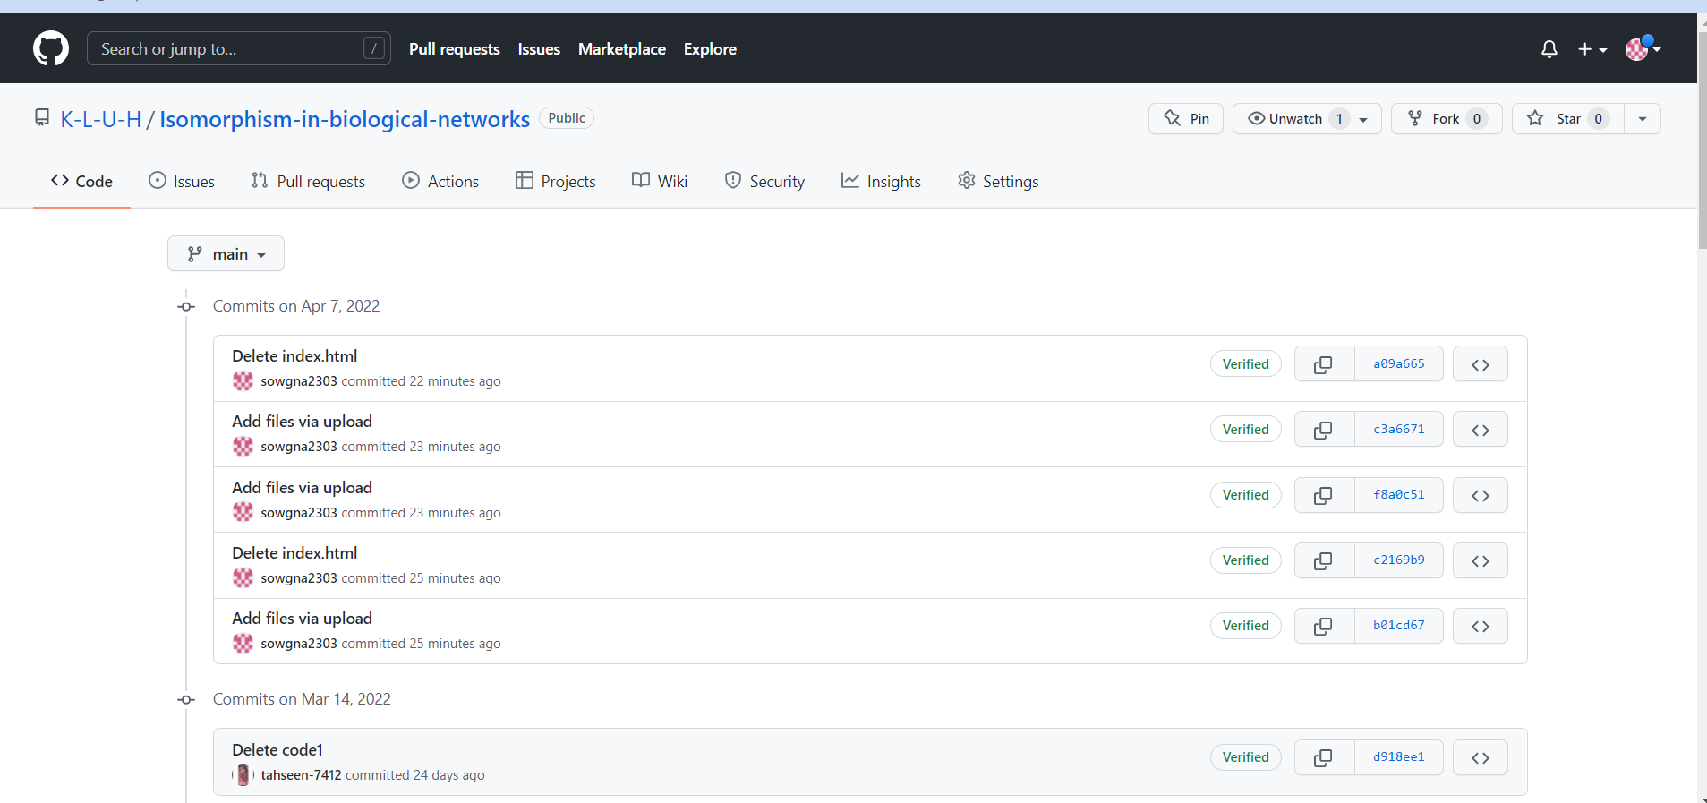
Github commits(35 commits)

Slide 12
Future scope of improvement
This project can be further enhanced to provide a 3D shape generator so that we can show the diagram in a 3D shape. Now it shows a normal diagram in the future we make that diagram into a 3D shape by doing the changes.

Slide 13
THANK YOU
Suggestions

